Slide 1

The Life and Times of a Pen Test Team
Octavio Paguaga
Phil Alter

Slide 2
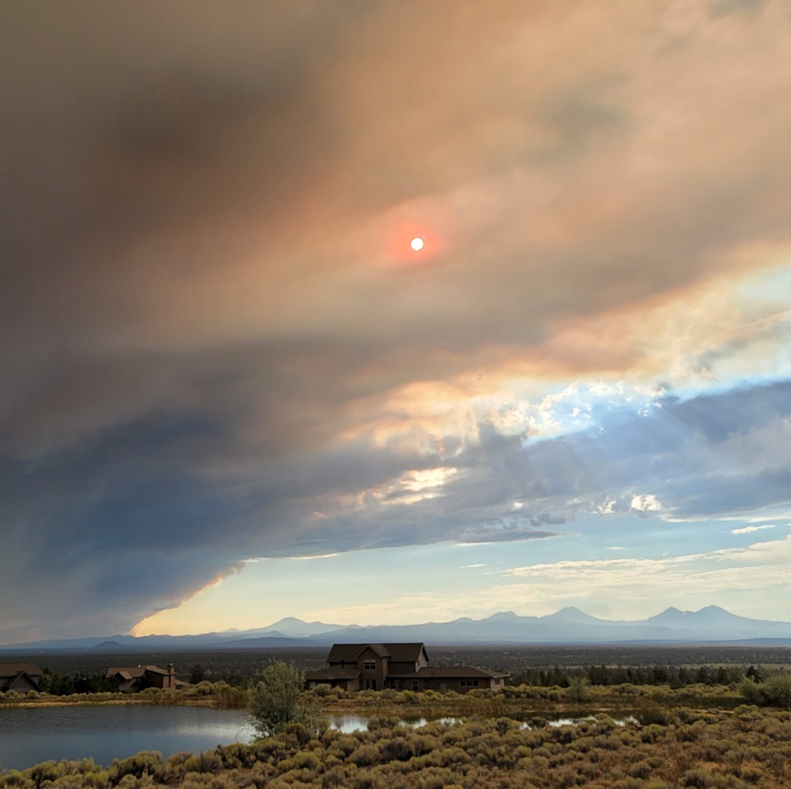
Octavio Paguaga
Former Principal Security Consultant at Trustwave Government Solutions.
Current Senior Security Consultant at CrowdStrike
Young family, and recently moved to Central Oregon from DC.
Notes:
You align text boxes as bad as shower tile. - PA

Slide 3




Phil Alter
Family man
Night owl fueled by caffeine
Hobbies include
Anything with engine
DIY
Cooking
Advocate for Autism Awareness
romz0mbie
romz0mbie
middleoftheweb.com
Notes:
Is this too flashy? - PA

Slide 4
A talk for everyone
We want this talk to discuss multiple aspects of a pentesting career, including but not limited to:
Highlight perspectives from a closely working team
Discuss roles
Discuss team dynamics
Advice
Interviewing
Public speaking
Hopefully, you’re able to take something away from this talk.
Notes:
Can we combine slides 5-7? - OP
Yes, we can, and I did. Also deleted the double presenter's slide, was meant more about throwing Charles in there and then I decided that his video would be enough, so it was a shit placeholder. – PA
Do the ‘elevator story’ - PA

Slide 5
How did I start my career?
Started in financial sector – Help Desk, Change & Incident Management, then Identity and Access Management
Introduced to fellow hackers at work (Thanks, PJ)
Started doing CTFs
Networked with Management
Met Octavio (Thanks, Ray)
Started as Security Consultant for Trustwave Government Solutions
2 years in November
Notes:
Is this too much, should I just minimize this to the other slide or combine them somehow? Not sure if this says “I’m talking about myself too much” or if it outlines a “Why I work the way I work”. - PA

Slide 6
What might I be doing – Junior Consultant?
Learn fundamentals
Build out scope
Understand the RoE - Critical
Start initial scanning
Get internal/external lay of the land
Perform OSINT if required, or other reconnaissance
Run through “the list”
Many teams establish a methodology
Kick off additional tooling
Responder/ntlmrelayx perhaps?
Note items of interest
Notes:
Does this look OK? I hope this doesn’t bump your slide deck too much. I’m not going into great detail on things, that’s someone elses tutorial, not mine. - PA

Slide 7
What might I be doing – Mid-level Consultant?
Set up infrastructure
C2 server (Cobalt Strike, Empire)
Phishing server (GoPhish, Zphisher)
Develop phishing campaign
Bad domains or goofy emails will get you caught
Create payloads
DueDLLigence + Mangle? Homebrew? Your choice
Utilize further tooling operations
Investigate items of interest
Aid Juniors

Slide 8
What might I be doing?
Responder
Poison LLMNR/mDNS/NBT-NS
ntlmrelayx
Relay all the things
Don’t forget SOCKS
Do you have a foothold?
Sharphound
Bloodhound
Kerberoasting
See if you can crack
Notes:
If you’re including an ntlmrelayx walkthrough, should I cut this out? - PA

Slide 9
Don’t forget the low hanging fruit!
Items I’ve seen commonly missed
Passwords in account descriptions
(do your ldap queries some justice!)
Stored credentials
Check printers
HP LaserJets are great
Discovered log files
Rees Scientific Presidio stores as base64
CUCM has these in plaintext
IPMI
Can go from zero to hero if reuse exists
Notes:
I think this is fine. - PA

Slide 10

A healthy, happy team
You’re with these folks for 40+ hours a week
You should be able to rely on your team
We have the same goal
“We are Voltron” – Charles Shirer
Schedules
Vacation
Long engagements
Some work friendships extend past the 9-5
We may have similar interests
Be there when their truck won’t start, or the bathroom tile isn’t cooperating
Notes:
I would use this slides’ talking points on the previous VOLTRON slide. I also don’t know how you present so.l….. – OP
I have no ideal what trail you went off at the end there, but yeah, I’m gonna mesh it together. I present like I talk – like shit – so buckle up, it’s gonna be a rollercoaster - PA

Slide 11
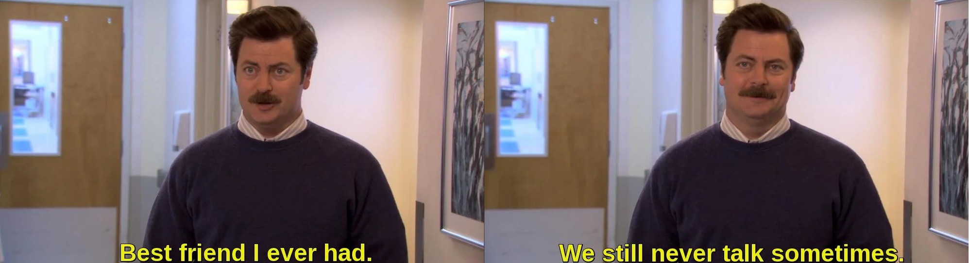
A healthy, happy team
Sometimes you might have disagreements
Sometimes you may never get to know someone, and that’s ok
Notes:
I love the image, but you just mentioned 9-5 in the previous slide. – OP
I took the 9-5 part out, I can make this flow together well. - PA

Slide 12

“The Boys”

Slide 13
“The Boys”
A solid network of others you can rely on, your 24/7 crew
New opportunities
Can help in a pinch
Learn new techniques
Support them
Previous co-workers
I’m currently presenting with one
Stay connected!
This part I’m horrible with – but I try!
Text, Discord, Twitter, Smoke signals

Slide 14
Things I wish I knew – Advice to others
Multiple ways to enter the field
Various certificates
eLearnSecurity, Pentester Academy, PNPT, CRTO
Networking is your friend
All backgrounds welcome
You. Will. Fail.
Learn. Understand. Overcome.
Burnout does happen
Take time for yourself
Keep your brain active
Notes:
You got anything to add here? - PA

Slide 15
Improvements to the Environment
Mentor others
Provide resources (Blogs, Labs, free to low-cost trainings)
Extend your hand (“Here’s my Twitter.”, “Shoot me an email if you need anything.”)
Share your knowledge
You’re likely not the only one to know
“Leave your ego at the door” – Charles Shirer
We’re all usually in this for the same reason
Your ‘stump the chump’ attempt will stay with someone.
Notes:
Thoughts? - PA

Slide 16
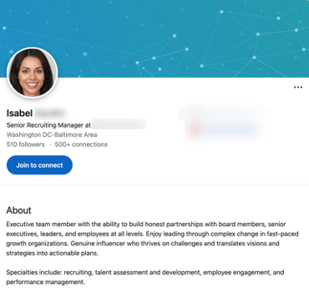
Hiring
”Isabel” will check your LinkedIn profile
You define what is in-scope
Turn on camera
Notes:
You wanna add a transition slide here? - PA

Slide 17

Interview Routine
Did they rehearse ahead of time?
How much practice did he and the dancers have ahead of time?
Do you think Lebron showed up only five minutes early?
Notes:
Hopefully their internet reaches out and isn’t just intranet, or you might wanna imbed that video - PA

Slide 18
Common Questions and Mistakes
Where are passwords stored in Linux?

Slide 19
Common Questions and Mistakes
Where are passwords in Linux stored?
/etc/shadow

Slide 20
Common Questions and Mistakes
Where are passwords in Linux stored?
What is Mimikatz?
/etc/shadow

Slide 21
Common Questions and Mistakes
Where are passwords in Linux stored?
What is Mimikatz?
What is NTLM Relaying
/etc/shadow
A tool to steal passwords from LSASS and Kerberos tickets.
Capturing NTLM authentication response to forwarding them to a machine without SMB Signing
Notes:
Weird break here, either do a slide for each, or do a left column for questions, then one for each question answer, same effect, different approach - PA

Slide 22
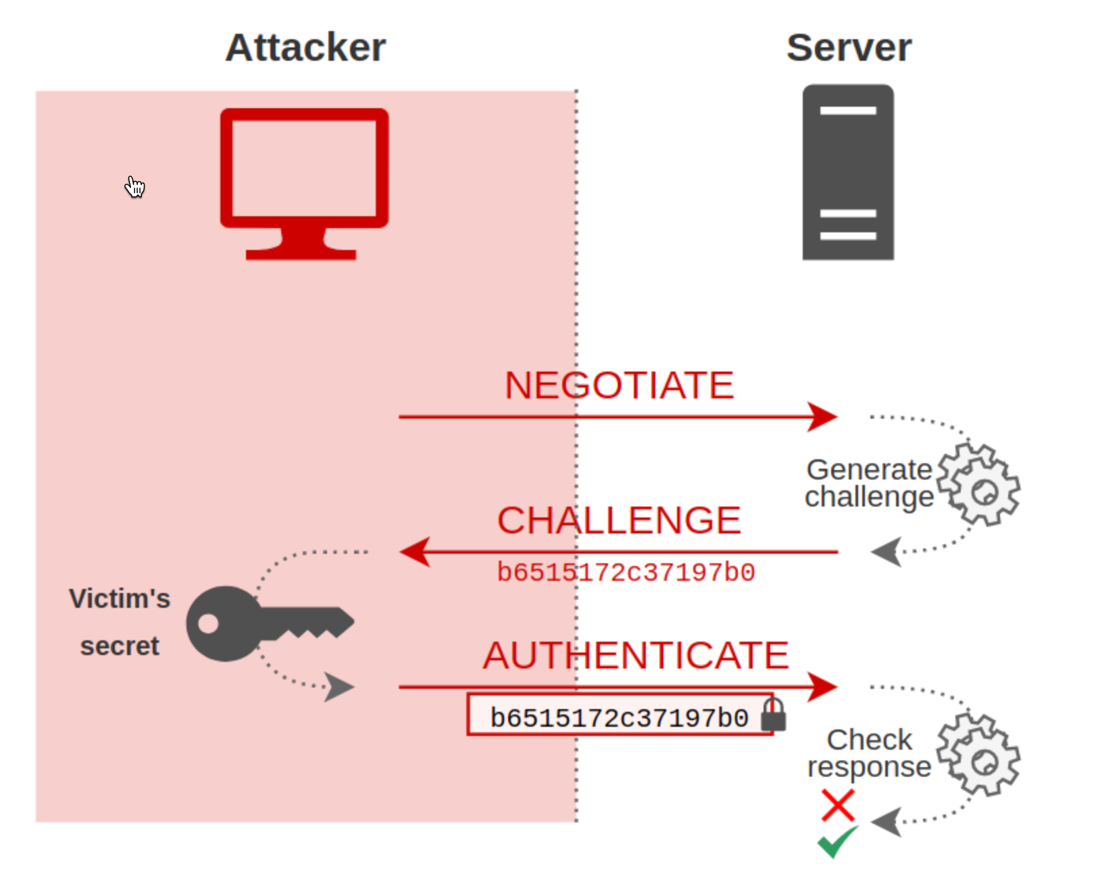
How Does NTLM Relay Work
https://en.hackndo.com/ntlm-relay/

Slide 23
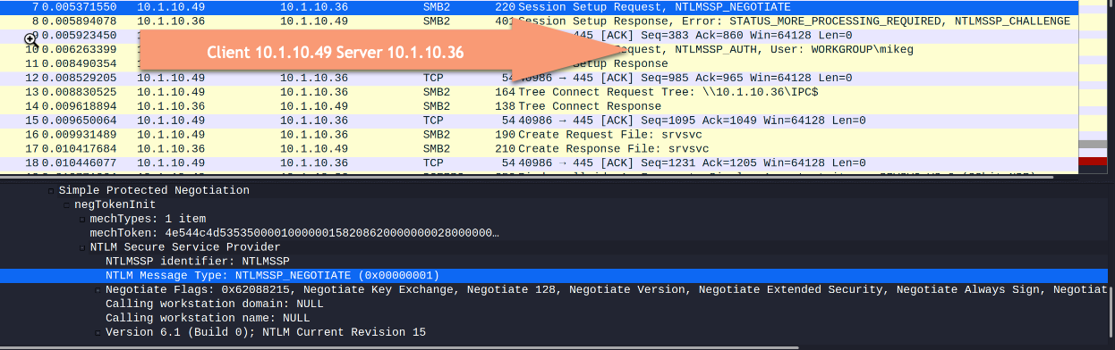
How does NTLM Relay work
https://en.hackndo.com/ntlm-relay/

Slide 24
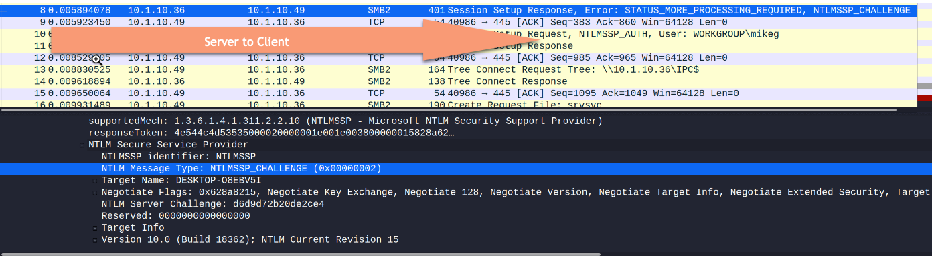
How does NTLM Relay work
https://en.hackndo.com/ntlm-relay/

Slide 25
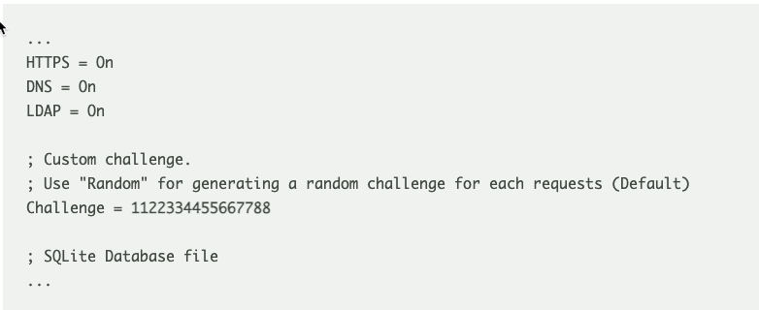
Modifying Responder to use a custom challenge
Below we will show you how to capture a NETNTLMv1 hash using Responder and then cracking the NTHASH (password equivalent) for free using our service which works 100% of the time.
Responder.conf file

Slide 26
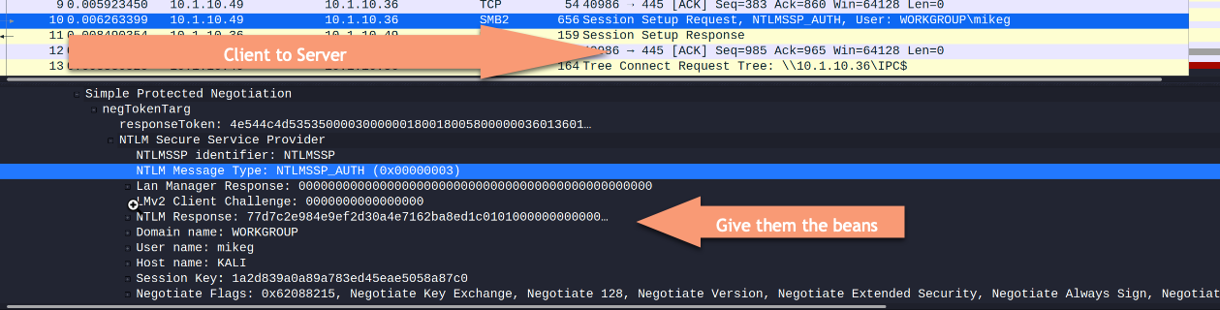
How does NTLM Relay work
https://en.hackndo.com/ntlm-relay/

Slide 27
Common Questions and Mistakes
Where are passwords in Linux stored?
What is Mimikatz?
What is NTLM Relaying
Walk me through a pen test with these guidelines
/etc/shadow
A tool to steal passwords from LSASS and Kerberos tickets.
Capturing NTLM authentication responses to forwarding them to a machine without SMB Signing

Slide 28
My Partial Answer
Capture hashes and/or relay credentials using responder and mitm6 along with ntlmrelayx.
Enumerate Active Directory using ntlmrelayx
Run bloodhound using bloodhound.py
Gain access to a computer using relayed credential. Will have to be a machine without SMB signing enabled
Enumerate SMB Shares looking for credentials.
Search for Local administrator permissions

Slide 29

Public Speaking
Glossophobia, or a fear of public speaking, is a very common phobia and one that is believed to affect up to 75% of the population.
A fear of public speaking often is present in individuals with social anxiety disorder, Dr. Strawn says, and these social anxiety disorders may affect 5 to 9% of Americans.
https://www.psycom.net/glossophobia-fear-of-public-speaking
Notes:
I fixed the picture. - PA

Slide 30

I took a job as a Cyber Security Instructor?

Slide 31
How I Improved my public speaking
Practice a lot

Slide 32
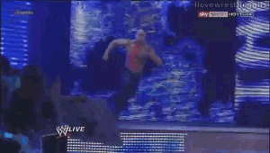
How I Improved my public speaking
Practice a lot
Get to class early, talk to students before lecture

Slide 33
How I Improved my public speaking
Practice a lot
Get to class early, talk to students before lecture
Notes:
Is this a duplicate without the GIF? - PA

Slide 34
How I Improved my public speaking
Practice a lot
Get to class early, talk to students before lecture
Do you

Slide 35
How I Improved my public speaking
Practice a lot
Get to class early, talk to students before lecture
Do you
Control the flow

Slide 36
How I Improved my public speaking
Practice a lot
Get to class early, talk to students before lecture
Do you!
Control the flow
Person in the first row with the red shirt. how long has it been since I’ve last spoken?

Slide 37
Acknowledgements
Nathan (@kryptops)
Ray (@pricklypaw)
Steve (@rvrsh3ll)
Charles (@bsdbandit)
Adam (@coffeegist)
Matt (@Tw1sm)
Jimmy (@bohops)
Notes:
I am not sure where to put this slide. Before I go into my stuff? – OP
Yeah, or we can nix it altogether, I’ll shorten mine if theres anyone/anything you want to add - PA

Slide 38

Notes:
Did you leave a cursor in the screenshot? - PA

Slide 39
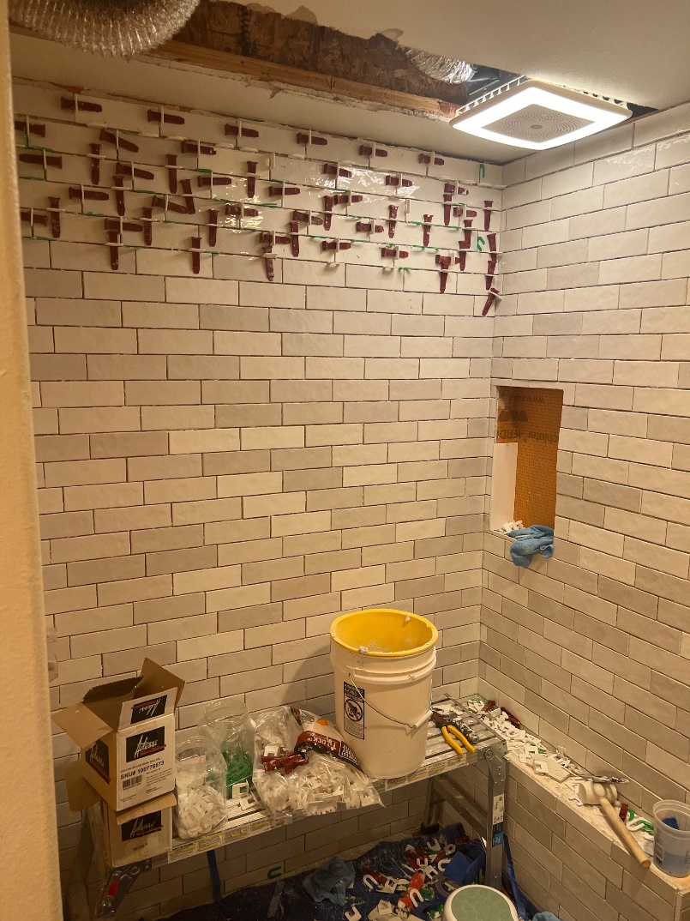
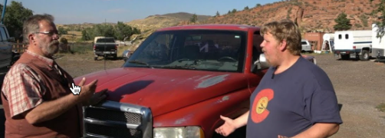
This was plan B
“10 Cummins hacks you need to know!” – BSidesDC 202X
“Aligning your tile with Python” – BSidesPDX 2023
Notes:
Plan B for what? - PA

Slide 40
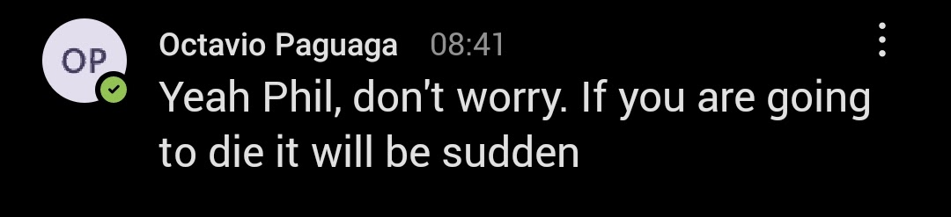
Notes:
Put in something funny - PA

Slide 41
Questions?

